Slide 1

JS CHALLENGES
Mohammad Kashif Sulaiman

Slide 2






MOHAMMAD KASHIF SULAIMAN
Full Stack Developer
Founder & CEO of
Top Rated Freelancer at
Senior Instructor at
Co-founder of
mohammadkashifsulaiman@gmail.com
Mohammad Kashif Sulaiman

Slide 3
Benefits of this session
Following skills will be boost
Dry run skills
Debugging skills
Logical skills
Programming skills

Slide 4
Lets Go!
Difficulty Level: Beginner

Slide 5
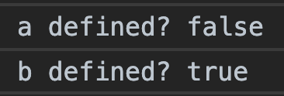
Challenge # 1.0
(function(){
var a = b = 3;
})();
console.log("a defined? " + (typeof a !== 'undefined'));
console.log("b defined? " + (typeof b !== 'undefined'));
Answer
Notes:
(function(){
var a = b = 3;
})();
console.log("a defined? " + (typeof a !== 'undefined'));
console.log("b defined? " + (typeof b !== 'undefined'));

Slide 6
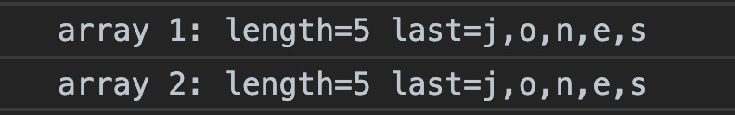
Challenge # 2.0
Answer
var arr1 = "john".split('');
var arr2 = arr1.reverse();
var arr3 = "jones".split('');
arr2.push(arr3);
console.log("array 1: length=" + arr1.length +
" last=" + arr1.slice(-1));
console.log("array 2: length=" + arr2.length +
" last=" + arr2.slice(-1));
Notes:
var arr1 = "john".split('');
var arr2 = arr1.reverse();
var arr3 = "jones".split('');
arr2.push(arr3);
console.log("array 1: length=" + arr1.length + " last=" + arr1.slice(-1));
console.log("array 2: length=" + arr2.length + " last=" + arr2.slice(-1));

Slide 7
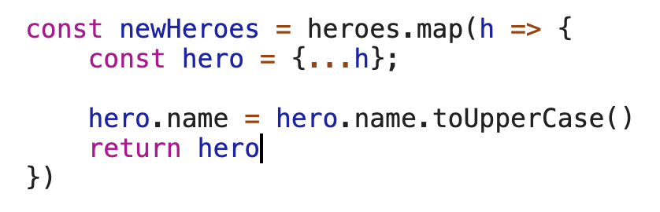
Challenge # 3.0
How to preserve the immutability on my heroes list?
const heroes = [
{ name: 'Wolverine', family: 'Marvel', isEvil: false },
{ name: 'Deadpool', family: 'Marvel', isEvil: false },
{ name: 'Magneto', family: 'Marvel', isEvil: true },
{ name: 'Charles Xavier', family: 'Marvel', isEvil: false },
{ name: 'Batman', family: 'DC Comics', isEvil: false },
{ name: 'Harley Quinn', family: 'DC Comics', isEvil: true },
{ name: 'Legolas', family: 'Tolkien', isEvil: false },
{ name: 'Gandalf', family: 'Tolkien', isEvil: false },
{ name: 'Saruman', family: 'Tolkien', isEvil: true }
]
const newHeroes = heroes.map(h => {
h.name = h.name.toUpperCase()
return h
})
Answer
Notes:
const heroes = [
{ name: 'Wolverine', family: 'Marvel', isEvil: false },
{ name: 'Deadpool', family: 'Marvel', isEvil: false },
{ name: 'Magneto', family: 'Marvel', isEvil: true },
{ name: 'Charles Xavier', family: 'Marvel', isEvil: false },
{ name: 'Batman', family: 'DC Comics', isEvil: false },
{ name: 'Harley Quinn', family: 'DC Comics', isEvil: true },
{ name: 'Legolas', family: 'Tolkien', isEvil: false },
{ name: 'Gandalf', family: 'Tolkien', isEvil: false },
{ name: 'Saruman', family: 'Tolkien', isEvil: true }
]
const newHeroes = heroes.map(h => {
h.name = h.name.toUpperCase()
return h
})

Slide 8
Challenge # 4.0
should be ==
; should be removed
‘-1’ should be removed
; should be removed
function displayEvenNumbers(){
var numbers = [1, 2, 3, 4, 5, 6, 7, 8];
var evenNumbers = [];
for(var i = 0; i < numbers.length - 1; i++;){
if(numbers % 2 = 0); {
evenNumbers.push(i);
}
return evenNumbers
}
}
displayEvenNumbers(); // should return [2,4,6,8]
should be numbers[i]
should be numbers[i]
should be put outside the for loop
Notes:
function displayEvenNumbers(){
var numbers = [1,2,3,4,5,6,7,8];
var evenNumbers = [];
for(var i=0; i<numbers.length-1; i++;){
if(numbers % 2 = 0); {
evenNumbers.push(i);
}
return evenNumbers;
}
}
displayEvenNumbers(); // should return [2,4,6,8]

Slide 9
Lets Go
Difficulty Level: Amateur

Slide 10

Challenge # 5.0
function callMe(list) {
var obj = {name: 'kashif'};
list.push(obj);
list.length = 2;
callYou(list);
}
function callYou(obj) {
obj.age = 23;
return obj;
}
callMe([{name: 'Javed'}, {name: 'Junaid'}, {name: 'Khurram'}])
Answer
Undefined
Notes:
function callMe(list) {
var obj = {name: 'kashif'};
list.push(obj);
list.length = 2;
callYou(list);
}
function callYou(obj) {
obj.age = 23;
return obj;
}
callMe([{name: 'Javed'}, {name: 'Junaid'}, {name: 'Khurram'}])

Slide 11
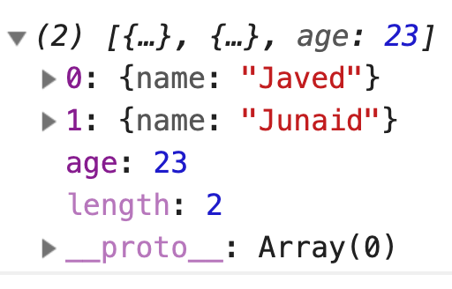
Challenge # 5.1
function callMe(list) {
var obj = {name: 'kashif'};
list.push(obj);
list.length = 2;
return callYou(list);
}
function callYou(obj) {
obj.age = 23;
return obj;
}
callMe([{name: 'Javed'}, {name: 'Junaid'}, {name: 'Khurram'}])
Answer
Notes:
function callMe(list) {
var obj = {name: 'kashif'};
list.push(obj);
list.length = 2;
return callYou(list);
}
function callYou(obj) {
obj.age = 23;
return obj;
}
callMe([{name: 'Javed'}, {name: 'Junaid'}, {name: 'Khurram'}])

Slide 12
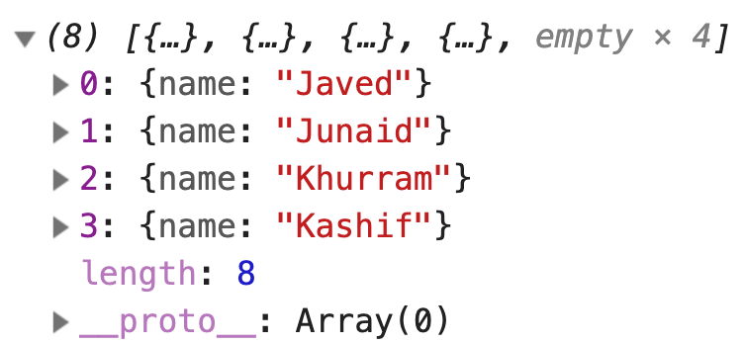
Challenge # 5.2
function callMe(list) {
var obj = {name: 'Kashif'};
list.push(obj);
list.length = 8;
return callYou(list);
}
function callYou(list) {
list.map(item => item.name.toLowerCase());
return list;
}
callMe([{name: 'Javed'}, {name: 'Junaid'}, {name: 'Khurram'}])
Answer
Notes:
function callMe(list) {
var obj = {name: 'Kashif'};
list.push(obj);
list.length = 8;
return callYou(list);
}
function callYou(list) {
list.map(item => item.name.toLowerCase());
return list;
}
callMe([{name: 'Javed'}, {name: 'Junaid'}, {name: 'Khurram'}])

Slide 13
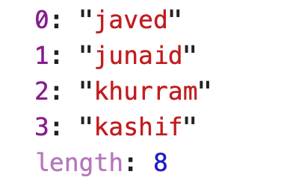
Challenge # 5.3
function callMe(list) {
var obj = {name: 'Kashif'};
list.push(obj);
list.length = 8;
return callYou(list);
}
function callYou(list) {
const newList = list.map(item => item.name.toLowerCase());
return newList;
}
callMe([{name: 'Javed'}, {name: 'Junaid'}, {name: 'Khurram'}])
Answer
Notes:
function callMe(list) {
var obj = {name: 'Kashif'};
list.push(obj);
list.length = 8;
return callYou(list);
}
function callYou(list) {
const newList = list.map(item => item.name.toLowerCase());
return newList;
}
callMe([{name: 'Javed'}, {name: 'Junaid'}, {name: 'Khurram'}])

Slide 14


Slide 15
Lets Go
Difficulty Level: Pro

Slide 16
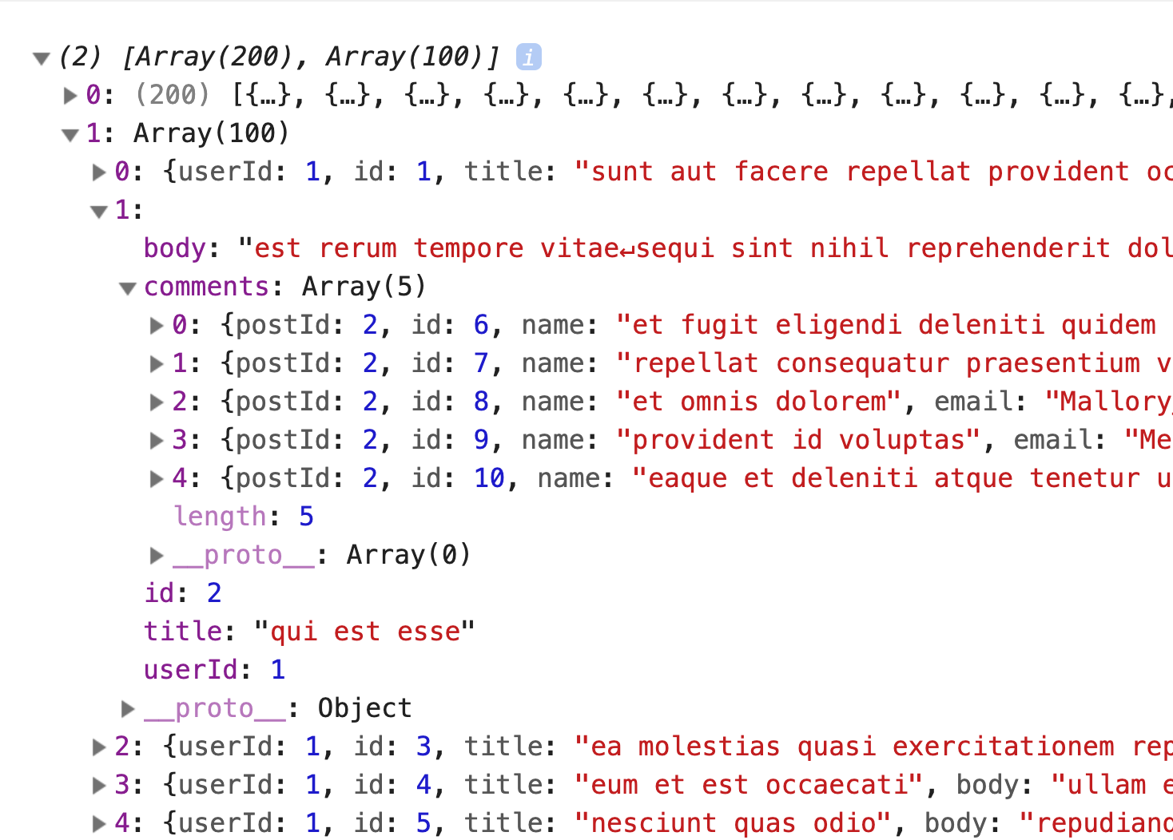
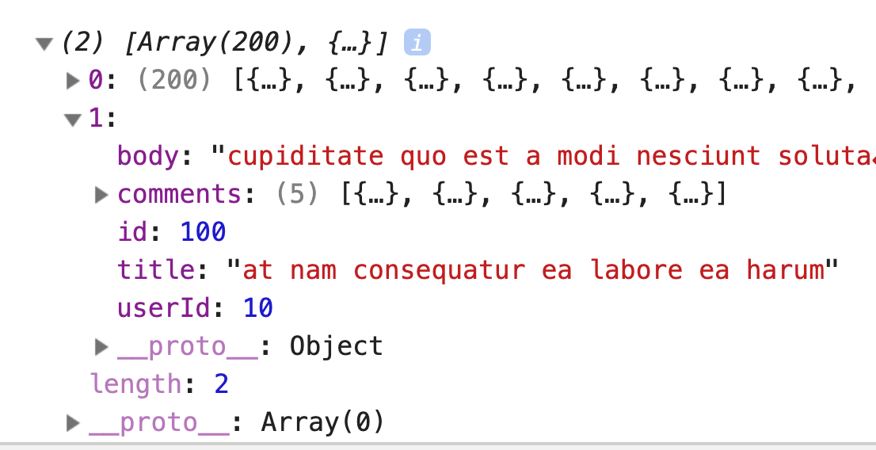
Challenge # 6.0
function getTodosAndPosts() {
const baseURL = "https://jsonplaceholder.typicode.com";
const promise1 = new Promise((resolve) => {
fetch(`${baseURL}/todos`).then(response => response.json())
.then(json => resolve(json))
})
const promise2 = new Promise((resolve) => {
fetch(`${baseURL}/posts`).then(response => response.json())
.then(posts => {
for(var i = 0; i < posts.length; i++) {
var post = posts[i];
fetch(`${baseURL}/comments?postId=${post.id}`).then(response => response.json())
.then(json => resolve({...post, comments: json}))
}
})
})
return Promise.all([promise1, promise2]);
}
Expected Output
Output
Notes:
function getTodosAndPosts() {
const baseURL = "https://jsonplaceholder.typicode.com";
const promise1 = new Promise((resolve) => {
fetch(`${baseURL}/todos`).then(response => response.json())
.then(json => resolve(json))
})
const promise2 = new Promise((resolve) => {
fetch(`${baseURL}/posts`).then(response => response.json())
.then(posts => {
for(var i = 0; i < posts.length; i++) {
var post = posts[i];
fetch(`${baseURL}/comments?postId=${post.id}`).then(response => response.json())
.then(json => resolve({...post, comments: json}))
}
})
})
return Promise.all([promise1, promise2]);
}

Slide 17
Challenge # 6.0 (Answer)
function getTodosAndPosts() {
const baseURL = "https://jsonplaceholder.typicode.com";
const promise1 = new Promise((resolve) => {
fetch(`${baseURL}/todos`)
.then(response => response.json())
.then(json => resolve(json))
})
const promise2 = new Promise((resolve) => {
fetch(`${baseURL}/posts`)
.then(response => response.json())
.then(posts => {
const promises = posts.map(post => {
return new Promise((resolve) => {
fetch(`${baseURL}/comments?postId=${post.id}`)
.then(response => response.json())
.then(json => resolve({...post, comments: json}))
})
})
Promise.all(promises).then(resolve);
})
})
return Promise.all([promise1, promise2]);
}
Output
Notes:
function getTodosAndPosts() {
const baseURL = "https://jsonplaceholder.typicode.com";
const promise1 = new Promise((resolve) => {
fetch(`${baseURL}/todos`)
.then(response => response.json())
.then(json => resolve(json))
})
const promise2 = new Promise((resolve) => {
fetch(`${baseURL}/posts`)
.then(response => response.json())
.then(posts => {
var promises = posts.map(post => {
return new Promise((resolve) => {
fetch(`${baseURL}/comments?postId=${post.id}`)
.then(response => response.json())
.then(json => resolve({...post, comments: json}))
})
})
Promise.all(promises).then(resolve);
})
})
return Promise.all([promise1, promise2]);
}

Slide 18


Slide 19
Thank you

